Slide 1
Compare MongoDB VS MySQL
BADA Abderrahmane
16/12/2022

Slide 2
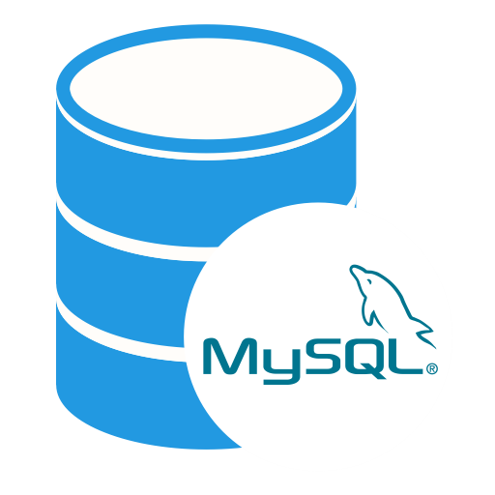
What is MySQL ?
MySQL is a relational database management system (RDBMS) from the Oracle Corporation.
MySQL stores data in tables and uses structured query language (SQL) for database access.
When MySQL developers need to access data in an application, they merge data from multiple tables together in a process called a join.

Slide 3

What is MongoDB ?
MongoDB is a NoSQL database that stores data as JSON-like documents.
Documents store related information together and use the MongoDB query language (MQL).
for access. Fields can vary from document to document - there is no need to declare the structure of documents to the system, as documents are self-describing.

Slide 4
MongoDB vs MySQL
Stats : 17.89% believed it as most wanted skill.
Database Structure : Uses JSON format to stare data.
Database Deployment : Supports Javascript , C++ and C effectively.
Performance & speed : Signle entity structure leading faster performance.
Security : Uses transport layer security & secure sockets.
Stats : 9.76% believed it as most wanted skill.
Database Structure : Uses defined table format to stare data.
Database Deployment : Supports C++ and C utmost effectively.
Performance & speed : slower performance because of tabular rendering.
Security : Security privilleges for robust authentication systems.

Slide 5
Should we choose MongoDB over MySQL?
MongoDB is an excellent choice if you target a modern database with real-time analytics, content management, and other flat operations. But you should go with MySQL if the database’s complexity is highly relational.

